Slide 1
Statistics in Medicine
Unit 1
Overview/Teasers

Slide 2
First rules of statistics…
Use common sense!
Draw lots of pictures!

Slide 3
What’s wrong with this?
Study with sample size of 10 (N=10)
Results: “Objective scoring by blinded investigators indicated that the treatment resulted in improvement in all (100%) of the subjects. Of patients showing overall improvement, 78% were graded as having either excellent or moderate improvement.”

Slide 4
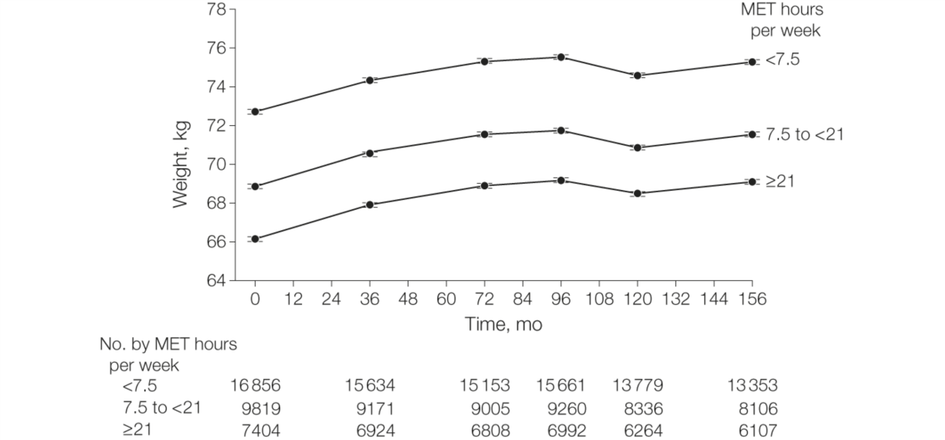
Take-home message?
Do the three groups differ meaningfully in weight change over time?
JAMA. 2010;303(12):1173-1179. doi:10.1001/jama.2010.312

Slide 5
Preview: Unit 1
How to think about, look at, and describe data

Slide 6
Teaser 1, Unit 1
Hypothetical randomized trial comparing two diets:
Those on diet 1 (n=10) lost an average of 34.5 lbs.
Those on diet 2 (n=10) lost an average of 18.5 lbs.
Conclusion: diet 1 is better?

Slide 7
Teaser 2, Unit 1
“400 shades of lipstick found to contain lead”, FDA says” Washington Post, Feb. 14, 2012
“What’s in Your Lipstick? FDA Finds Lead in 400 Shades,” Time.com February 15, 2012
How worried should women who use lipstick be?

Slide 8
Statistics in Medicine
Module 1:
Introduction to Data

Slide 9
Example Data
Data compiled from previous Stanford students (anonymous, non-identifiable)
Sample size = 50

Slide 10
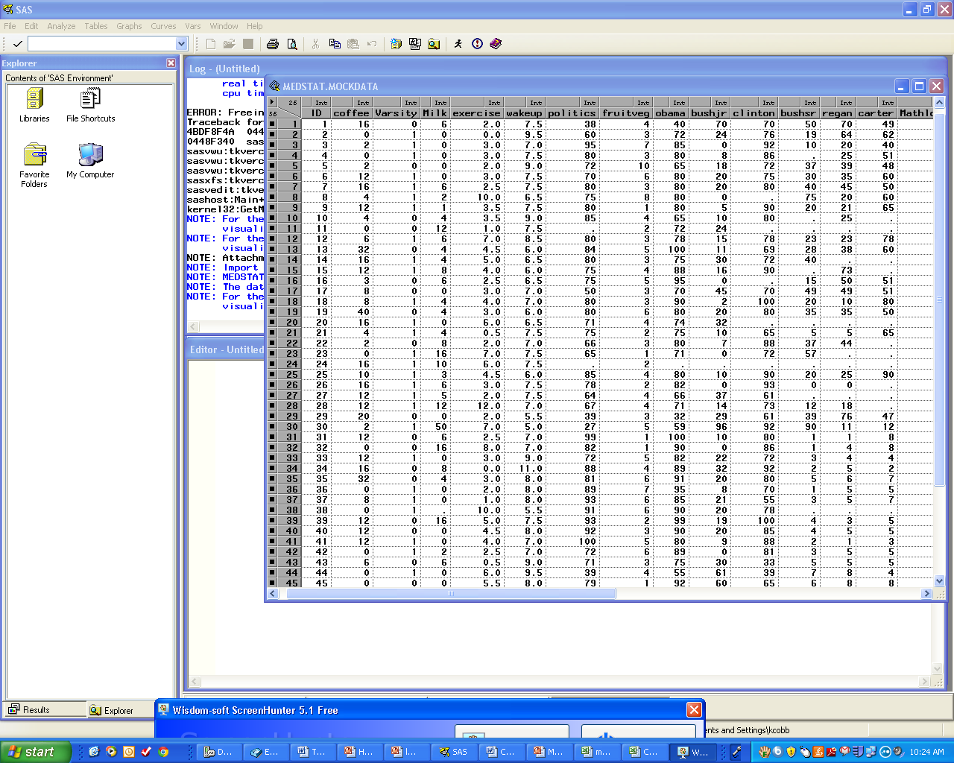
Example Data Set

Slide 11
Each row stores the data for 1 student (1 observation).

Slide 12
Each column stores the values for 1 variable (e.g., ounces of coffee per day).

Slide 13
Missing Data!

Slide 14
Statistics in Medicine
Module 2:
Types of Data

Slide 15
Types of data
  Quantitative
  Categorical (nominal or ordinal)
  Time-to-event

Slide 16
Quantitative variable
Numerical data that you can add, subtract, multiply, and divide
Examples:
  Age
  Blood pressure
  BMI
  Pulse
Examples from our example data:
  Optimism on a 0 to 100 scale
  Exercise in hours per week
  Coffee drinking in ounces per day

Slide 17
Quantitative variable
Continuous vs. Discrete
  Continuous: can theoretically take on any value within a given range (e.g., height=68.99955… inches)
  Discrete: can only take on certain values (e.g., count data)

Slide 18
Categorical Variables
Binary = two categories
    Dead/alive
    Treatment/placebo
    Disease/no disease
    Exposed/Unexposed
    Heads/Tails
    Example data: played varsity sports in high school (yes/no)

Slide 19
Categorical Variables
Nominal = unordered categories
    The blood type of a patient (O, A, B, AB)
    Marital status
    Occupation

Slide 20
Categorical Variables
Ordinal = Ordered categories
    Staging in breast cancer as I, II, III, or IV
    Birth order—1st, 2nd, 3rd, etc.
    Letter grades (A, B, C, D, F)
    Ratings on a Likert scale (e.g., strongly agree, agree, neutral, disagree, strongly disagree)
    Age in categories (10-20, 20-30, etc.)
    Example data: non-drinker, light drinker, moderate drinker, and heavy drinker of coffee
Notes:
That's really what distinguishes these from discrete numerical

Slide 21
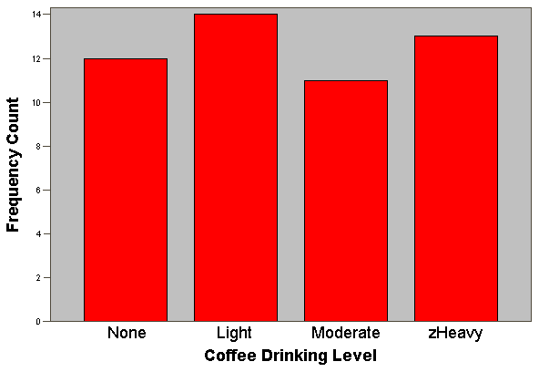
Coffee Drinking Categories (Ordinal)

Slide 22
Time-to-event variables
The time it takes for an event to occur, if it occurs at all
Hybrid variable—has a continuous part (time) and a binary part (event: yes/no)
Only encountered in studies that follow participants over time—such as cohort studies and randomized trials
Examples:
  Time to death
  Time to heart attack
  Time to chronic kidney disease

Slide 23
Statistics in Medicine
Module 3:
Looking at Data

Slide 24
Always Plot Your Data!
✓ Are there “outliers”?
✓ Are there data points that don’t make sense?
✓ How are the data distributed?

Slide 25
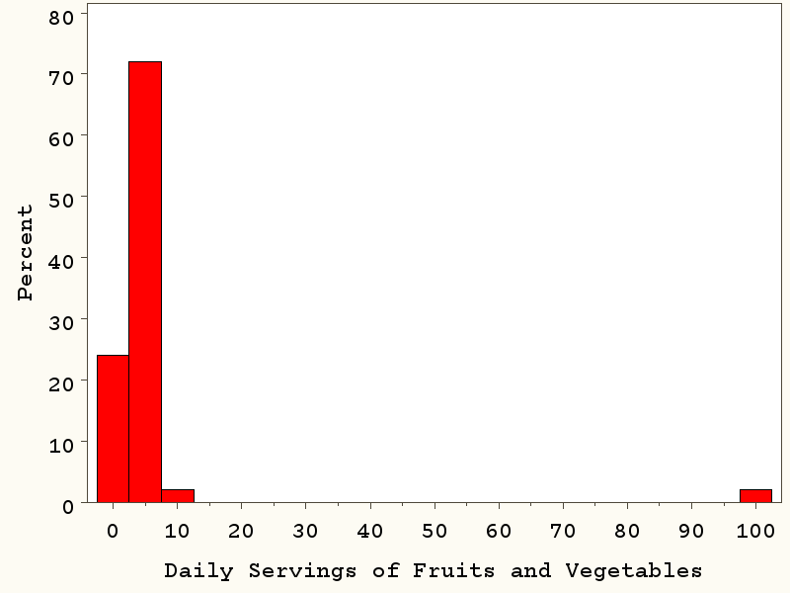
Are there points that don’t make sense?
Oops!

Slide 26
How are the data distributed?
  Categorical data:
    What are the N’s and percents in each category?
  Quantitative data:
    What’s the shape of the distribution (e.g., is it normally distributed or skewed)?
    Where is the center of the data?
    What is the spread/variability of the data?

Slide 27
Frequency Plots (univariate)
  Categorical variables
  Bar Chart
  Quantiative/continuous variables
  Box Plot
  Histogram

Slide 28
Bar Chart
Used for categorical variables to show frequency or proportion in each category.

Slide 29
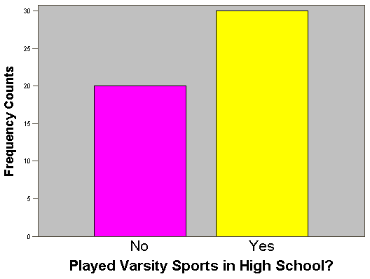
Bar Chart: categorical variables

Slide 30
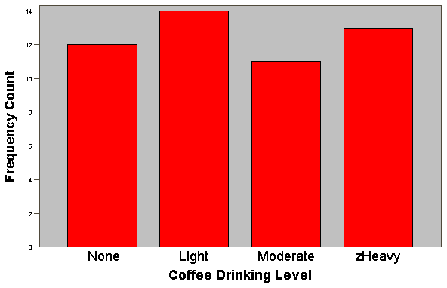
Bar Chart: categorical variables

Slide 31
Box plot and histograms: for quantitative variables
To show the distribution (shape, center, range, variation) of quantitative variables.
Notes:
Does everybody know what I mean when I say percentiles?
What is the median? Anyone?

Slide 32
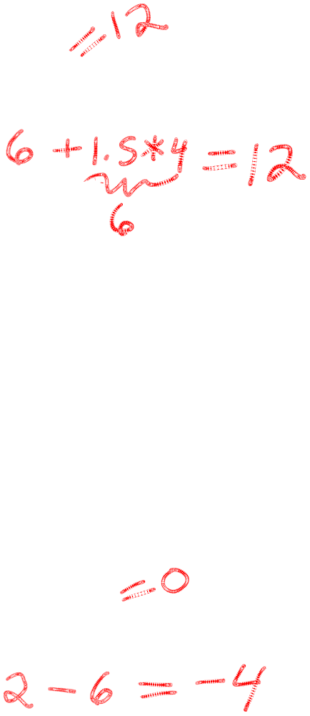
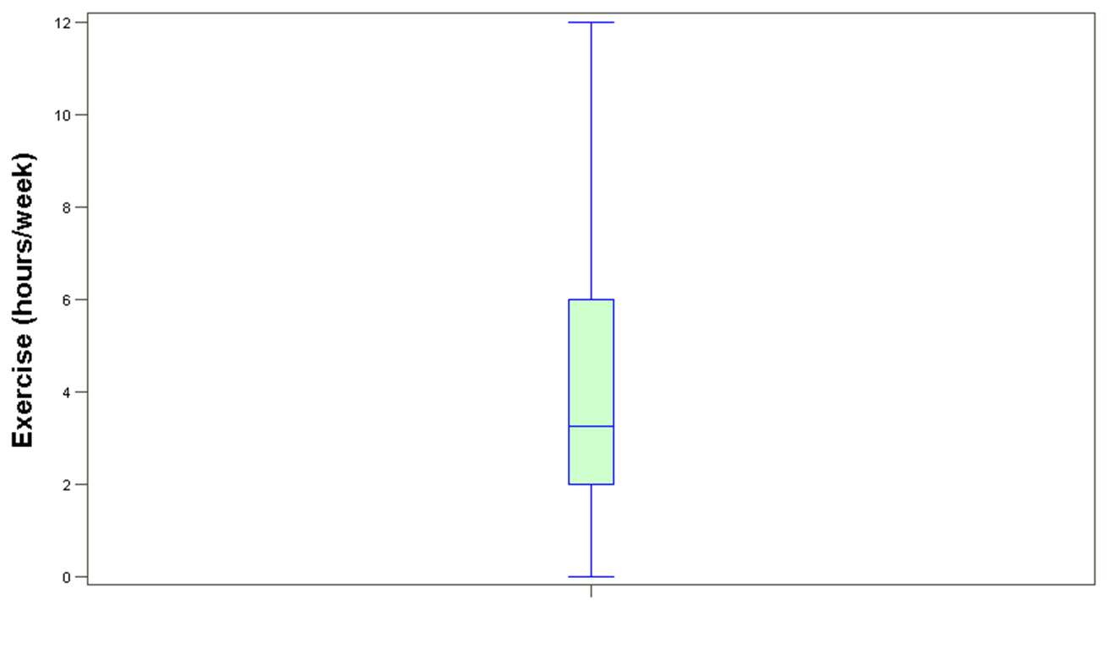
Boxplot of Exercise
maximum or
Q3 + 1.5 * IQR
75th percentile (6)
interquartile range
(IQR) = 6-2 = 4
median (3.25)
25th percentile (2)
minimum or
Q1 - 1.5 * IQR
Notes:
Lower of the maximum or this other quantity.
Higher of the minimum or this other quantity.

Slide 33
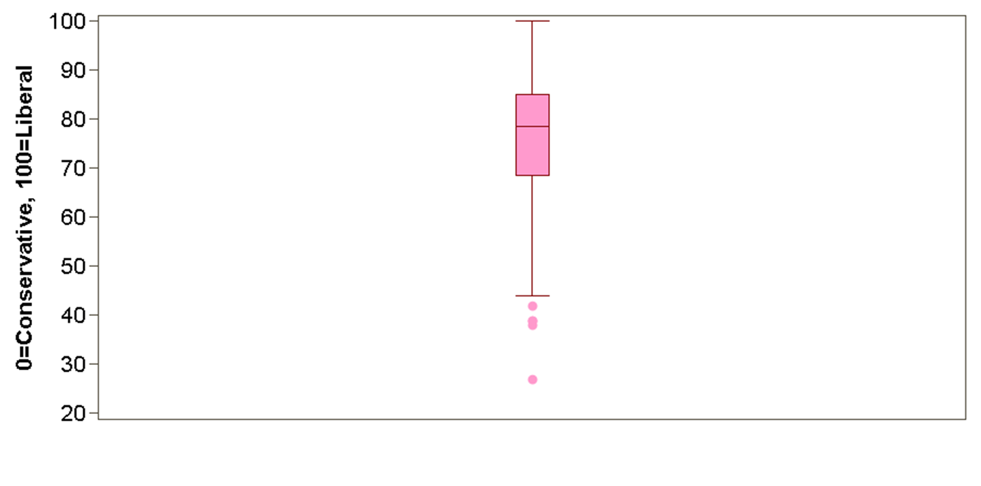
Boxplot of Political Bent
(0=Most Conservative, 100=Most Liberal)
maximum (100)
75th percentile (85)
interquartile range
(IQR) = 85 – 68 = 17
median (78)
25th percentile (68)
Q1 – 1.5 * IQR =
68 – 1.5 * 17 = 42.5
“outliers”
minimum (27)
Notes:
If we were on a bell curve, outliers lie outside of the middle 99.3% of the data.
Minimum here is 27.
Outlier doesn’t mean error in the data! Don’t just throw out!

Slide 34
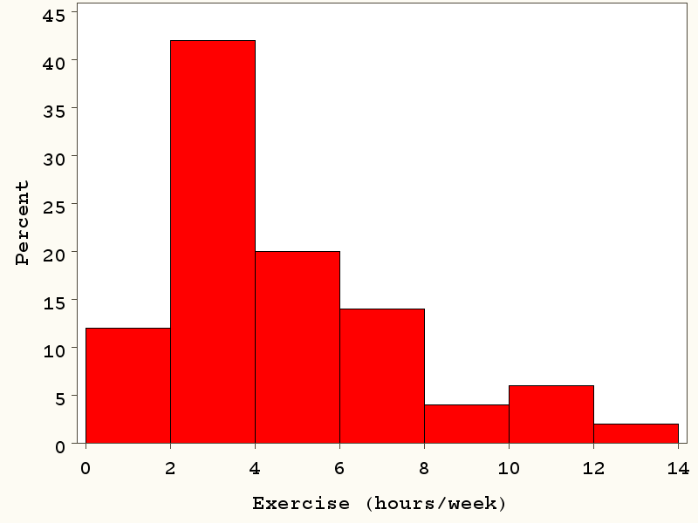
Histogram of Exercise
Y-axis: The percent of observations that fall within each bin.
Bins of size = 2 hours/week
Notes:
Divide the variable into bins of equal size.

Slide 35
Histogram of Exercise
Bins of size = 2 hours/week
42% of students (n=21) exercise between 2 and 3.999… hours per week.
12% of students (n=6) exercise between 0 and 1.999… hours per week.
Notes:
Total area under the curve is 1.0.
2. How many people do you think are in bin 125-135?
3. Where do you think the center of the data are (what's your best guess at the average weight)?
4. On average, how far do you think a given woman is from 127 -- the center/mean?

Slide 36
Histogram of Exercise
Bins of size = 2 hours/week
2% of students (n=1) exercise ≥ 12 hr/wk
Notes:
Total area under the curve is 1.0.
2. How many people do you think are in bin 125-135?
3. Where do you think the center of the data are (what's your best guess at the average weight)?
4. On average, how far do you think a given woman is from 127 -- the center/mean?

Slide 37
Histogram of Exercise
Bins of size = 2 hours/week
Note the “right skew”
Notes:
Note how easy to glean information from this graph.
2. How many people do you think are in bin 125-135?
3. Where do you think the center of the data are (what's your best guess at the average weight)?
4. On average, how far do you think a given woman is from 127 -- the center/mean?

Slide 38
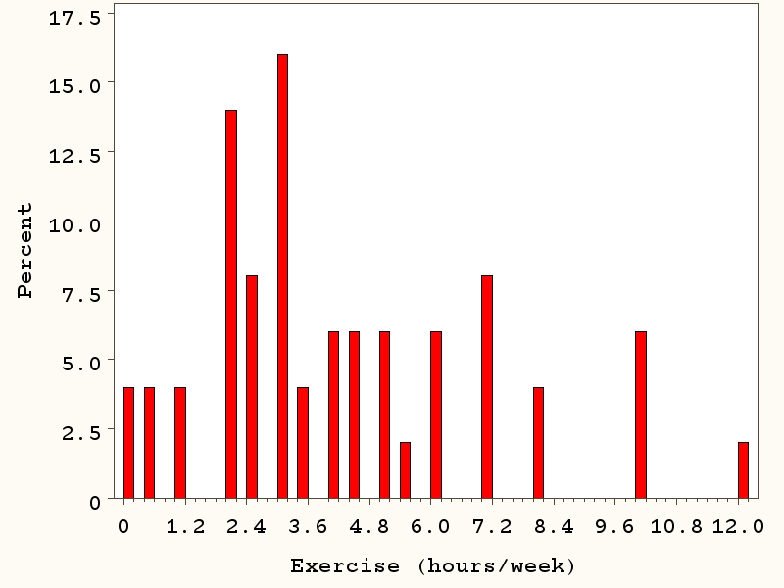
Histogram of Exercise
Bins of size = 0.2 hours/week
Too much detail!
Notes:
Bin sizes may be altered.
2. How many people do you think are in bin 125-135?
3. Where do you think the center of the data are (what's your best guess at the average weight)?
4. On average, how far do you think a given woman is from 127 -- the center/mean?

Slide 39
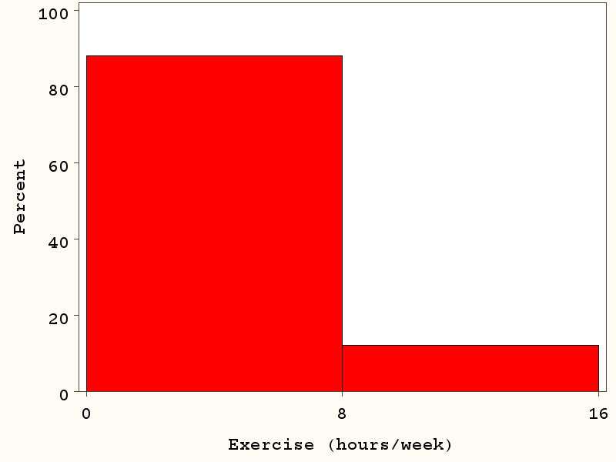
Histogram of Exercise
Bins of size = 8 hours/week
Too little detail!
Notes:
1. Bin sizes may be altered.
2. How many people do you think are in bin 125-135?
3. Where do you think the center of the data are (what's your best guess at the average weight)?
4. On average, how far do you think a given woman is from 127 -- the center/mean?

Slide 40
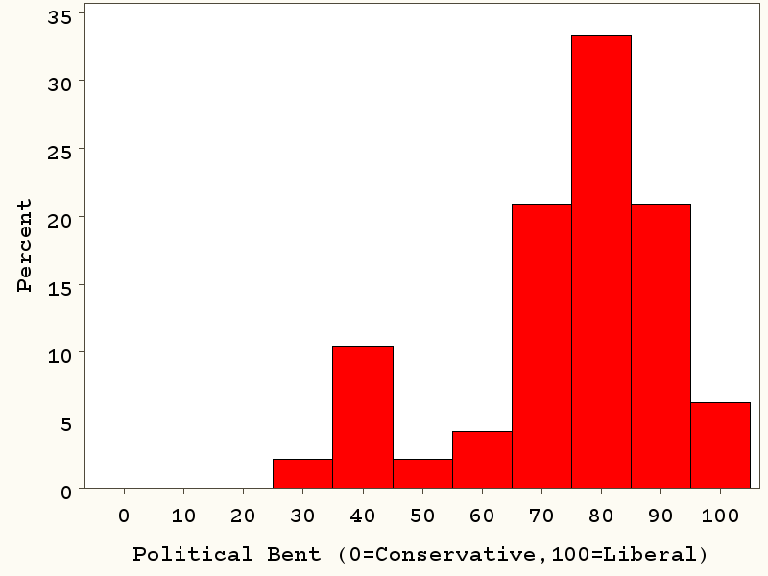
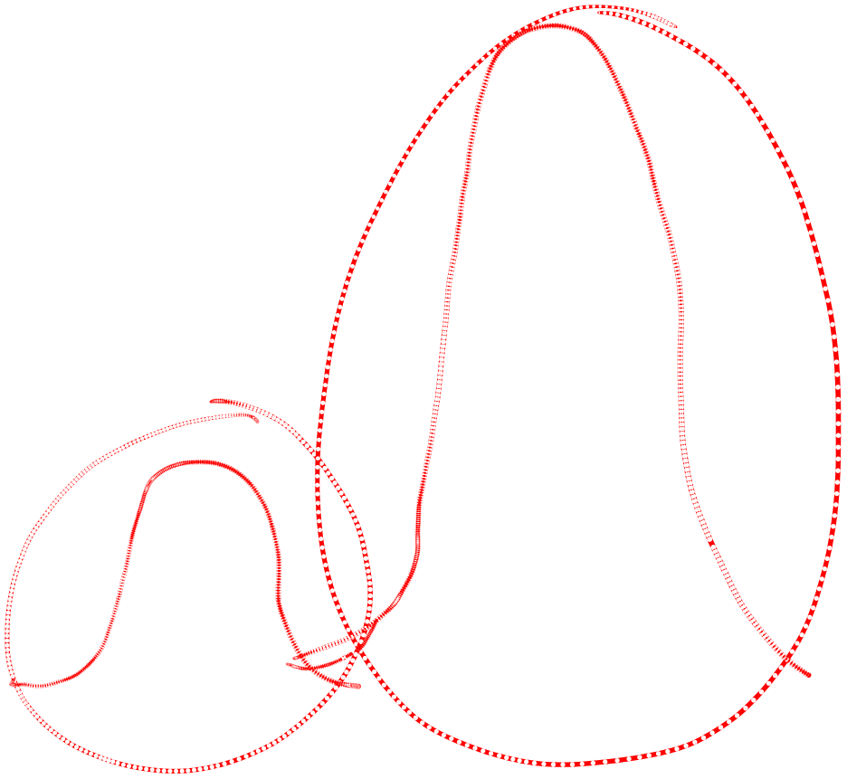
Histogram of Political Bent
Note the “left skew”
Also, could be described as “bimodal” (two peaks, two groups)
Notes:
Set up the histogram slightly different. Bin sizes are 10. 25 to 35, 45 to 55, etc.
We might call this bimodal.

Slide 41
Shape of a Distribution
Left-skewed/right-skewed/symmetric
Left-Skewed
Symmetric
Right-Skewed

Slide 42
Shape of a Distribution
Symmetric
  Bell curve (“normal distribution”)

Slide 43
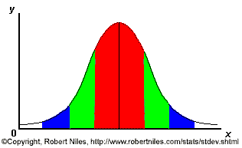
Normal distribution (bell curve)
Useful for many reasons:
-Has predictable behavior
-Many traits follow a normal distribution in the population
**Many statistics follow a normal distribution (more on this later!)**
68% of the data
95% of the data
99.7% of the data
Notes:
SAY: within 1 standard deviation either way of the mean
within 2 standard deviations of the mean
within 3 standard deviations either way of the mean
WORKS FOR ALL NORMAL CURVES NO MATTER HOW SKINNY OR FAT

Slide 44
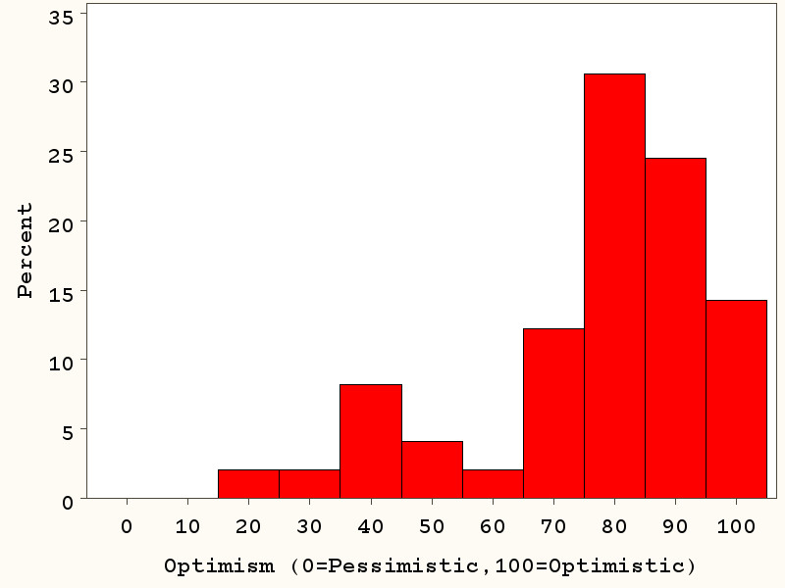
Example data: Optimism…

Slide 45
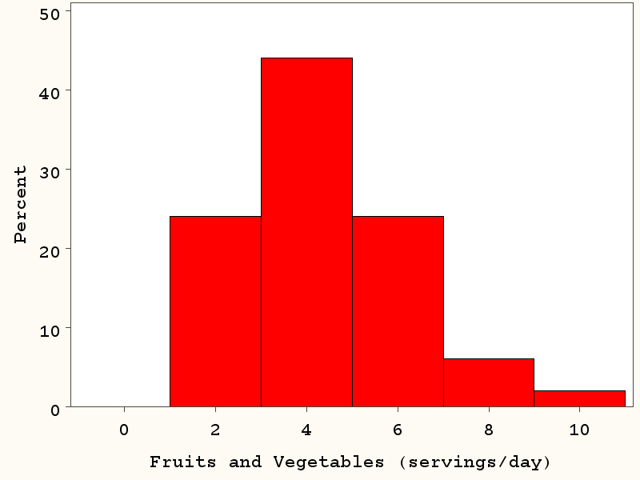
Fruit and vegetable consumption (servings/day)…

Slide 46
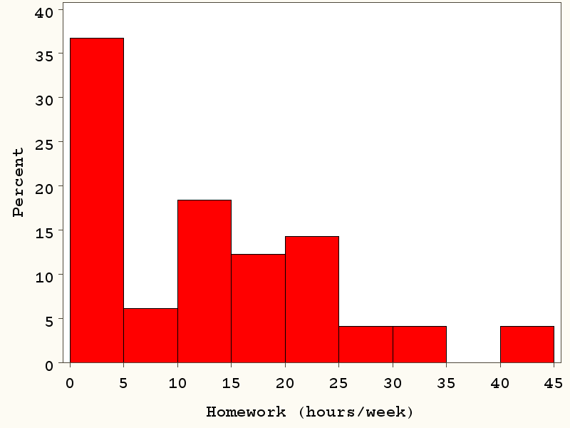
Homework (hours/week)…

Slide 47
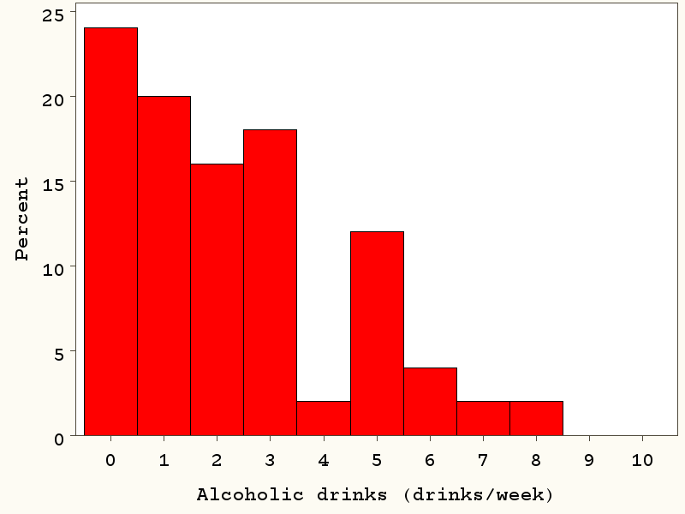
Alcohol (drinks/week)

Slide 48
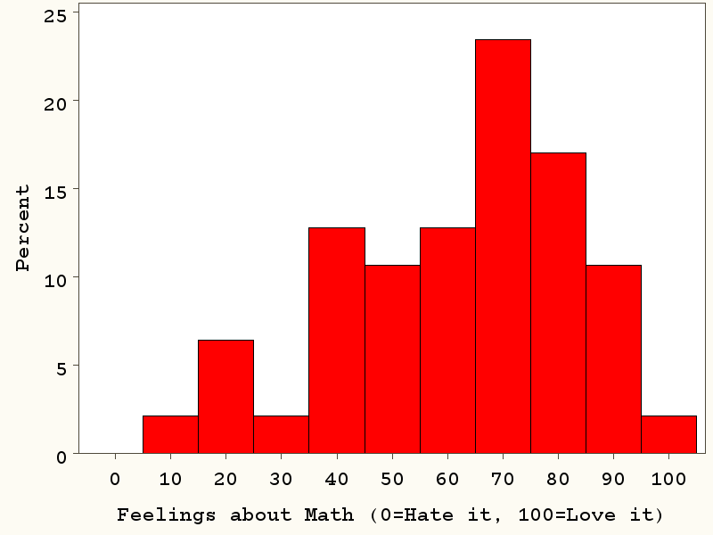
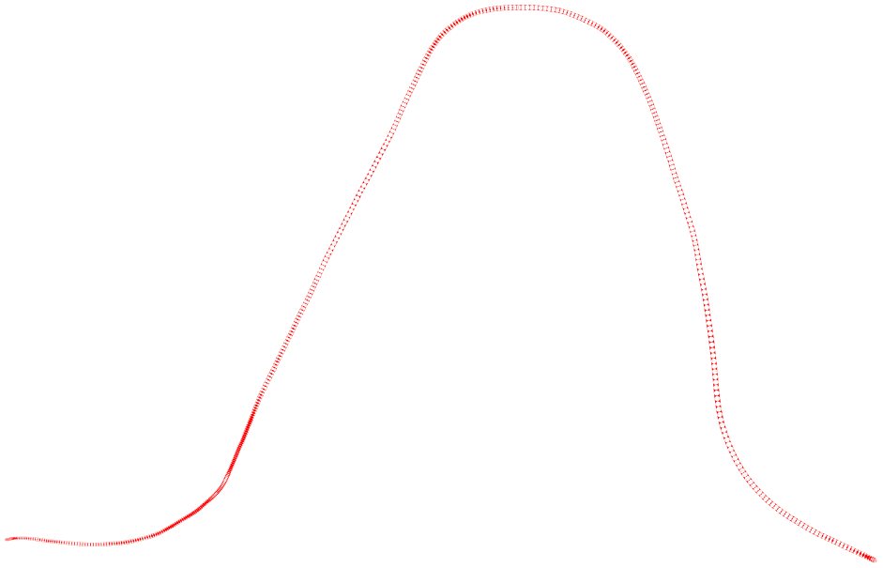
Feelings about math (0=lowest, 100=highest)
Closest to a normal distribution!

Slide 49
Statistics in Medicine
Module 4:
Describing Quantitative Data: Where is the center?

Slide 50
Measures of “central tendency”
Mean
Median

Slide 51
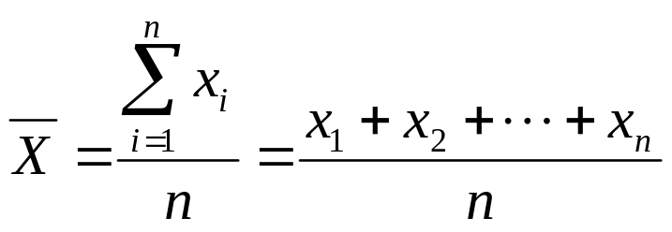
Mean
Mean – the average; the balancing point
  calculation: the sum of values divided by the sample size
In math shorthand:
Notes:
Balance the Bell Curve on a point. Where is the point of balance, average mass on each side.

Slide 52
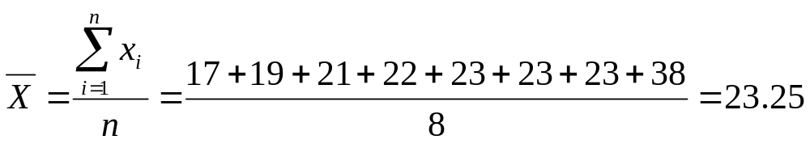
Mean: example
  Some data:
  Age of participants: 17 19 21 22 23 23 23 38

Slide 53
Mean of homework
Mean= 11.4 hours/week
The balancing point

Slide 54
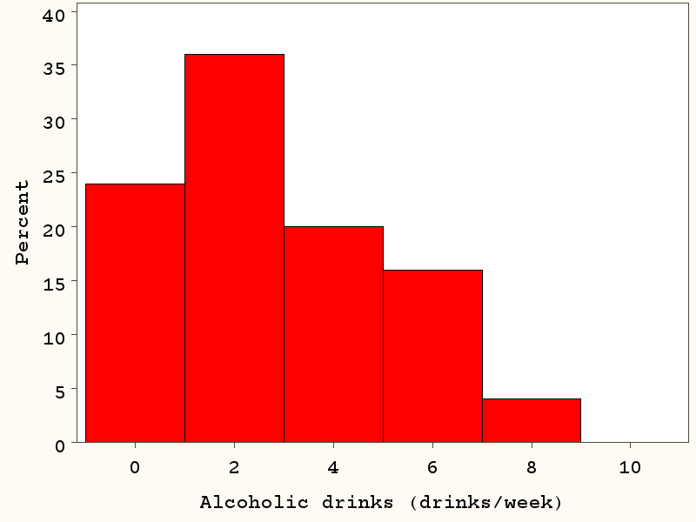
The mean is affected by extreme values…
Mean= 2.3 drinks/week
The balancing point

Slide 55
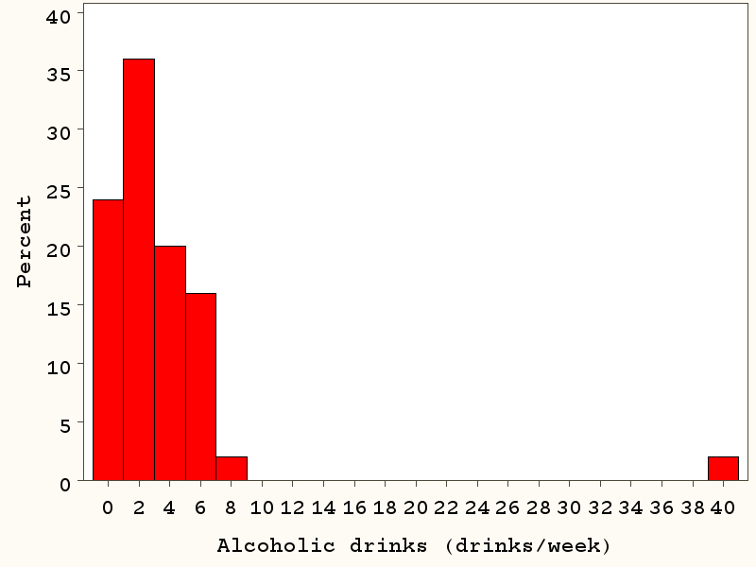
The mean is affected by extreme values…
Mean= 2.9 drinks/week

Slide 56
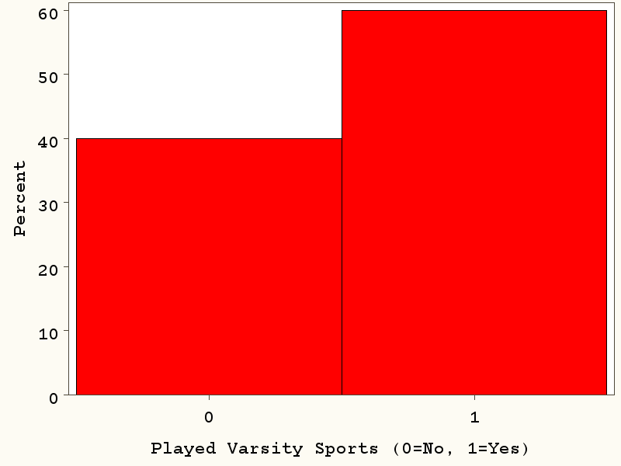
Does a binary variable have a mean?
Yes! If coded as a 0/1 variable…
Example: Played Varsity Sports in High School (0=no, 1=yes)
60% (30)
40% (20)

Slide 57
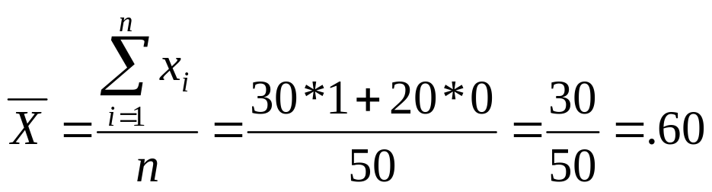
Does a binary variable have a mean?
60% (30)
40% (20)

Slide 58
Central Tendency
Median – the exact middle value
Calculation:
If there are an odd number of observations, find the middle value
If there are an even number of observations, find the middle two values and average them.

Slide 59
Median: example
  Some data:
  Age of participants: 17 19 21 22 23 23 23 38
Median = (22+23)/2 = 22.5

Slide 60
Median of homework
50%
of mass
50%
of mass
Median= 10 hours/week

Slide 61
Median of alcohol drinking
50%
of mass
50%
of mass
Median= 2.0 drinks/wk

Slide 62
The median is NOT affected by extreme values…

Slide 63
The median is NOT affected by extreme values…
50%
of mass
50%
of mass
Median = 2.0 drinks/week

Slide 64
Does Varsity Sports (binary variable) have a median?
Yes, if you line up the 0’s and 1’s, the middle number is 1.
60% (30)
40% (20)

Slide 65
Should I present means or medians?
For skewed data, the median is preferred because the mean can be highly misleading…

Slide 66
Hypothetical example: means vs. medians…
10 dieters following diet 1 vs. 10 dieters following diet 2
Group 1 (n=10) loses an average of 34.5 lbs.
Group 2 (n=10) loses an average of 18.5 lbs.
Conclusion: diet 1 is better?

Slide 67
Histogram, diet 2…
30
Mean=-18.5 pounds
Median=-19 pounds
25
20
P
e
r
c
15
e
n
t
10
5
0
-30
-25
-20
-15
-10
-5
0
5
10
15
20
Weight change

Slide 68
Histogram, diet 1…
30
Mean=-34.5 pounds
Median=-4.5 pounds
25
20
P
e
r
c
15
e
n
t
10
5
0
-300
-280
-260
-240
-220
-200
-180
-160
-140
-120
-100
-80
-60
-40
-20
0
20
Weight Change

Slide 69
The data…
Diet 1, change in weight (lbs):
+4, +3, 0, -3, -4, -5, -11, -14, -15, -300
Diet 2, change in weight (lbs)
-8, -10, -12, -16, -18, -20, -21, -24, -26, -30

Slide 70
Compare medians via a “non-parametric test”
We need to compare medians (ranked data) rather than means; requires a “non-parametric test”
Apply the Wilcoxon rank-sum test (also known as the Mann-Whitney U test) as follows…

Slide 71
Rank the data…
Diet 1, change in weight (lbs):
+4, +3, 0, -3, -4, -5, -11, -14, -15, -300
Ranks: 1 2 3 4 5 6 9 11 12 20
Diet 2, change in weight (lbs)
-8, -10, -12, -16, -18, -20, -21, -24, -26, -30
Ranks: 7 8 10 13 14 15 16 17 18 19

Slide 72
Sum the ranks…
Diet 1, change in weight (lbs):
+4, +3, 0, -3, -4, -5, -11, -14, -15, -300
Ranks: 1 2 3 4 5 6 9 11 12 20
Sum of the ranks: 1+2+3+4 +5 +6+9+11+12 +20 = 73
Diet 2, change in weight (lbs)
-8, -10, -12, -16, -18, -20, -21, -24, -26, -30
Ranks: 7 8 10 13 14 15 16 17 18 19
Sum of the ranks: 7+8+10+13 +14 +15+16+17+18 +19 = 137
Diet 2 is superior to Diet 1, p=.018.

Slide 73
Statistics in Medicine
Module 5:
Describing Quantitative Data: What is the variability in the data?

Slide 74
Measures of Variability
Range
Standard deviation/Variance
Percentiles
Inter-quartile range (IQR)

Slide 75
Range
Difference between the largest and the smallest observations.

Slide 76
Range of homework: 40 hours – 0 hours = 40 hours/wk

Slide 77
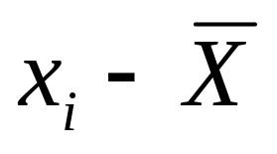
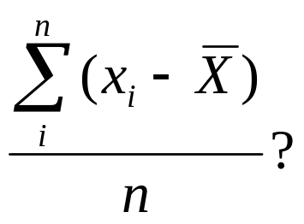
Standard deviation
Challenge: devise a statistic that gives the average distance from the mean.
Distance from the mean:
Average distance from the mean??:

Slide 78
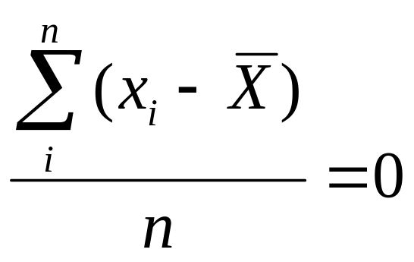
Standard deviation
But this won’t work!

Slide 79
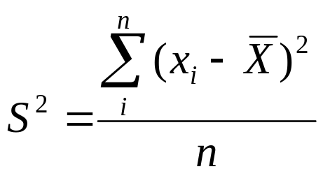
How can I get rid of negatives?
Absolute values?
  Too messy mathematically!
Squaring eliminates negatives!

Slide 80
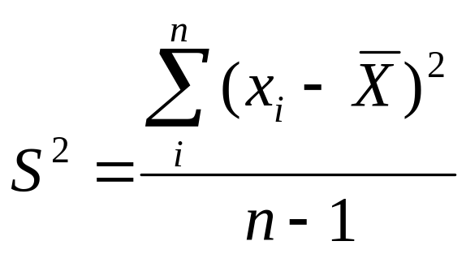
Variance
Average squared distance from the mean:
We lose a “degree of freedom because we have already estimated the mean.

Slide 81
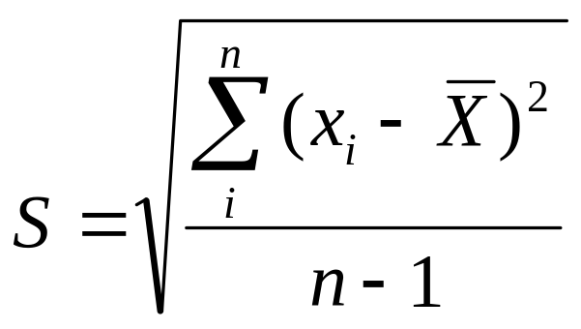
Standard Deviation
Gets back to the units of the original data
Roughly, the average spread around the mean.

Slide 82
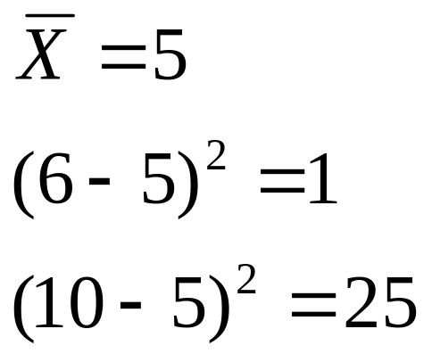
The standard deviation is affected by extreme values
Because of the squaring, values farther from the mean contribute more to the standard deviation than values closer to the mean:

Slide 83
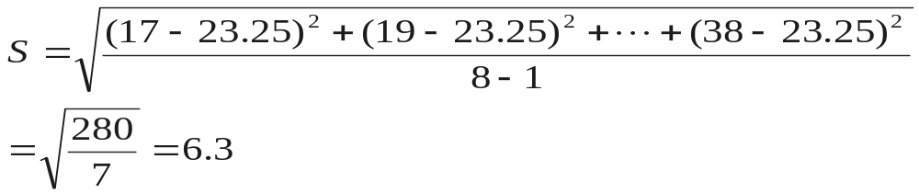
Calculation Example:
Standard Deviation
Age data (n=8) : 17 19 21 22 23 23 23 38
n = 8 Mean = 23.25

Slide 84
Homework (hours/week)
Mean = 11.4
Standard deviation = 10.5
Notes:
If you remove the one person who reported 40 hours/week, the std. dev goes down to 9.8.

Slide 85
Feelings about math (0=lowest, 100=highest)
Mean = 61
Standard deviation = 21

Slide 86
68-95-99.7 rule (for a perfect bell curve)
68% of the data
95% of the data
99.7% of the data
Notes:
SAY: within 1 standard deviation either way of the mean
within 2 standard deviations of the mean
within 3 standard deviations either way of the mean
WORKS FOR ALL NORMAL CURVES NO MATTER HOW SKINNY OR FAT

Slide 87
Feelings about math (0=lowest, 100=highest)
Mean +/- 1 std =
40 – 82
Percent between 40 and 82 = 34/47 = 72%

Slide 88
Feelings about math (0=lowest, 100=highest)
Mean +/- 2 std =
19 – 100
Percent between 19 and 100 = 46/47= 98%

Slide 89
Feelings about math (0=lowest, 100=highest)
Mean +/- 3 std =
0 – 100
100% of the data!

Slide 90
Does a binary variable have a standard deviation?
Yes! If coded as a 0/1 variable…
Example: Played Varsity Sports in High School (0=no, 1=yes)
60% (30)
40% (20)

Slide 91
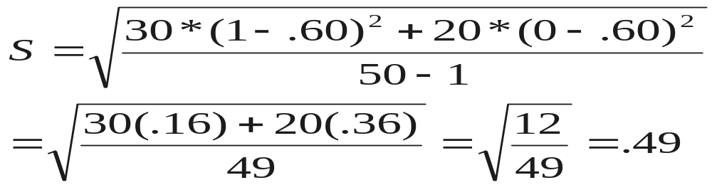
Does a binary variable have a standard deviation?
60% (30)
40% (20)

Slide 92
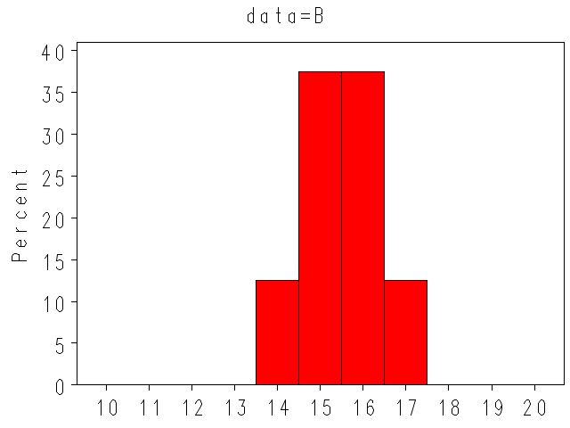
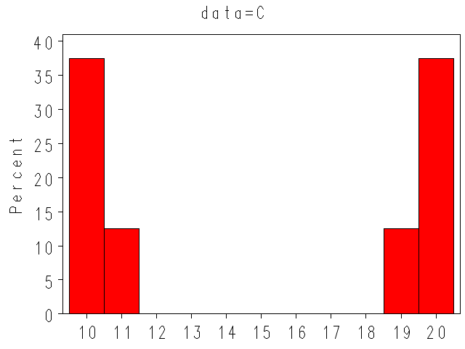
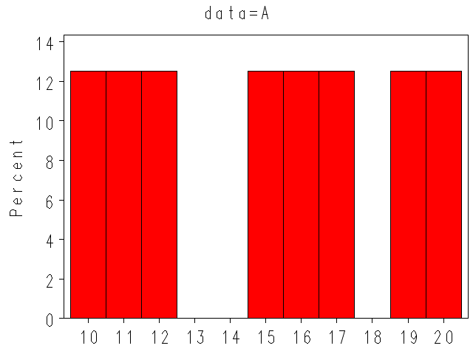
Understanding Standard Deviation:
Mean = 15
S = 0.9
Mean = 15
S = 3.7
Mean = 15
S = 5.1

Slide 93
Standard deviations vs. standard errors
Standard deviation measures the variability of a trait.
Standard error measures the variability of a statistic, which is a theoretical construct! (much more on this later!)

Slide 94
Percentiles
Based on ranking the data
  The 90th percentile is the value for which 90% of observations are lower
  The 50th percentile is the median
  The 10th percentile is the value for which 10% of observations are lower
Percentiles are not affected by extreme values (unlike standard deviations)

Slide 95
Interquartile Range (IQR)
Interquartile range = 3rd quartile – 1st quartile
The middle 50% of the data.
Interquartile range is not affected by outliers.

Slide 96
Boxplot of Political Bent
(0=Most Conservative, 100=Most Liberal)
75th percentile (85)
interquartile range
(IQR) = 85 – 68 = 17
25th percentile (68)
Notes:
If we were on a bell curve, outliers lie outside of the middle 99.3% of the data.
Minimum here is 27.
Outlier doesn’t mean error in the data! Don’t just throw out!

Slide 97
Symbols
S²= Sample variance
S = Sample standard deviation
σ² = Population (true or theoretical) variance
σ = Population standard deviation
X = Sample mean
µ = Population mean
IQR = interquartile range (middle 50%)

Slide 98
Statistics in Medicine
Module 6:
Exploring real data: Lead in lipstick

Slide 99
2007 Headlines
“Lipsticks Contain Excessive Lead, Tests Reveal”
“One third of lipsticks on the market contain high lead”
Link to example news coverage: http://www.reuters.com/article/2007/10/11/us-lipstick-lead-idUSN1140964520071011

Slide 100
2007 report by a consumer advocacy group…
“One-third of the lipsticks tested contained an amount of lead that exceeded the U.S. Food and Drug Administration’s 0.1 ppm limit for lead in candy—a standard established to protect children from ingesting lead.”

Slide 101
2007 report by a consumer advocacy group…
“One-third of the lipsticks tested contained an amount of lead that exceeded the U.S. Food and Drug Administration’s 0.1 ppm limit for lead in candy—a standard established to protect children from ingesting lead.”
1 ppm = 1 part per million =1 microgram/gram

Slide 102
Recent Headlines
“400 shades of lipstick found to contain lead”, FDA says” Washington Post, Feb. 14, 2012
“What’s in Your Lipstick? FDA Finds Lead in 400 Shades,” Time February 15, 2012
Link to example news coverage:
http://healthland.time.com/2012/02/15/whats-in-your-lipstick-fda-finds-lead-in-400-shades/

Slide 103
How worried should women be?
What is the dose of lead in lipstick?
How much lipstick are women exposed to?
How much lipstick do women ingest?

Slide 104
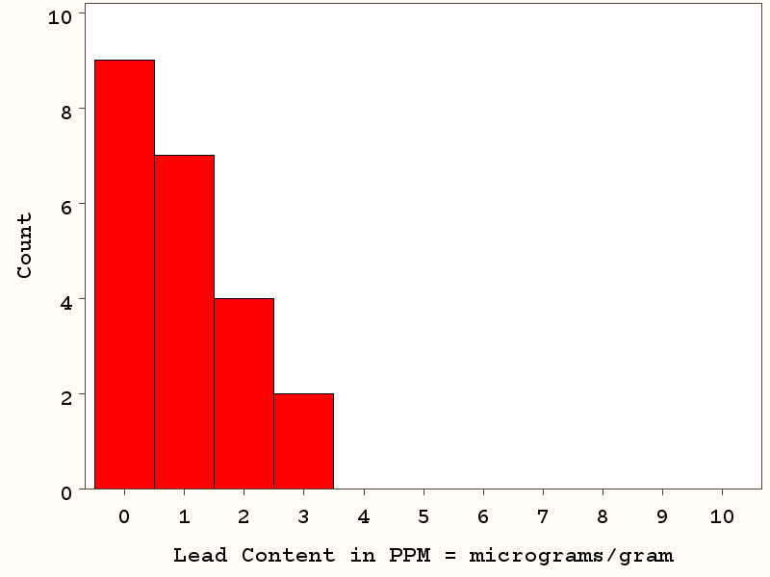
Distribution of lead in lipstick (FDA 2009, n=22)
Right-skewed!
Mean = 1.07 micrograms/gram
Median = 0.73
Std. Dev = 0.96
max = 3.06
99th percentile : 3.06
95th percentile: 3.05
90th percentile: 2.38
75th percentile: 1.76

Slide 105
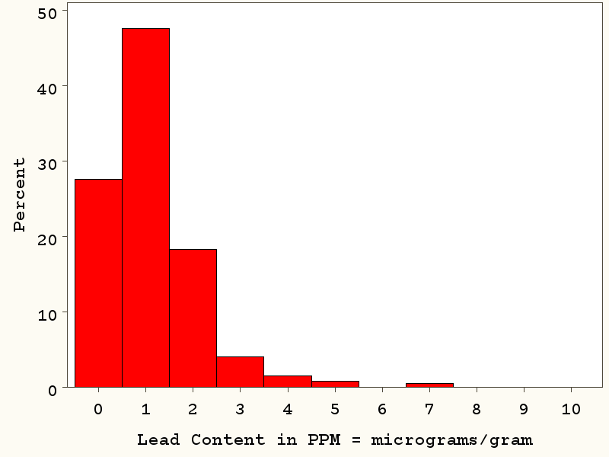
Distribution of lead in lipstick (FDA 2012, n=400)
Right-skewed!
Mean = 1.11 micrograms/gram
Median = 0.89
Std. Dev = 0.97
max = 7.19
99th percentile : 4.91
95th percentile: 2.76
90th percentile: 2.23
75th percentile: 1.50

Slide 106
FDA 2009 (n=22) vs. FDA 2012 (n=400)
2009 (n=22)
Mean = 1.07 micrograms/gram
Median = 0.73
Std. Dev = 0.96
max = 3.06
99th percentile : 3.06
95th percentile: 3.05
90th percentile: 2.38
75th percentile: 1.76
2012 (n=400)
Mean = 1.11 micrograms/gram
Median = 0.89
Std. Dev = 0.97
max = 7.19
99th percentile : 4.91
95th percentile: 2.76
90th percentile: 2.23
75th percentile: 1.50

Slide 107
Distribution of lead in lipstick (FDA 2012, n=400)
Right-skewed!
Mean = 1.11 micrograms/gram
Median = 0.89
Std. Dev = 0.97
max = 7.19
99th percentile : 4.91
95th percentile: 2.76
90th percentile: 2.23
75th percentile: 1.50

Slide 108
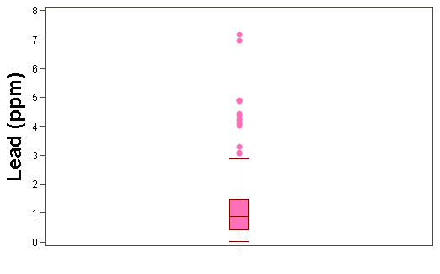
Distribution of lead in lipstick (n=400 samples, FDA 2012)
FDA data available at: http://www.fda.gov/Cosmetics/ProductandIngredientSafety/ProductInformation/ucm137224.htm#expanalyses

Slide 109
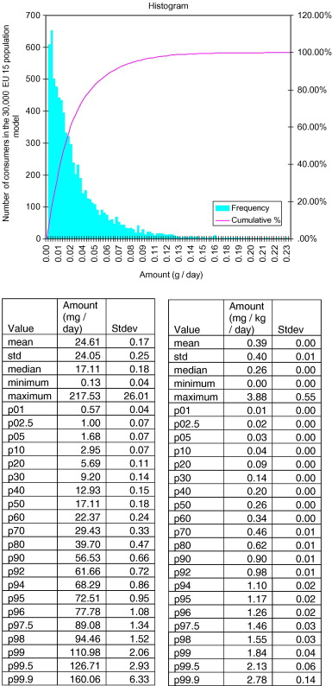
Data on lipstick exposure
Fig. 6 Lipstick exposure for women in grams/day.
Percentiles in mg/day
Hall B, Tozer S, Safford B, Coroama M, Steiling W, Leneveu-Duchemin MC, McNamara C, Gibney M. European consumer exposure to cosmetic products, a framework for conducting population exposure assessments. Food and Chemical Toxicology 2007; 45: 2097 – 2108.

Slide 110
Distribution of lipstick exposure:
Percentiles in mg/day
Food and Chemical Toxicology 2007; 45: 2097 – 2108.

Slide 111
Highest use (1 in 30,000 women)
1 in 30,000 women uses 218 milligrams of lipstick per day.
1 tube of lipstick contains 4000 milligrams.
4000 mg/tube ÷ 218 mg/day = 18 days per tube.
The heaviest user goes through an entire tube of lipstick in 18 days.

Slide 112
Exercise
Lead in lipstick:
Median = 0.89 micrograms/gram
Maximum = 7.19 mcg/g
  Assuming that women ingest 50% of the lipstick they apply daily, calculate:
  What is the typical lead exposure to lipstick for women, in micrograms (mcg) of lead (based on medians)?
  What is the highest daily lead exposure to lipstick for women, in mcg of lead?
Daily lipstick usage:
Median = 17.11 milligrams
Maximum = 217.53 mg

Slide 113
Typical user
Daily exposure:
Daily ingestion:

Slide 114
Typical user
Daily exposure:
0.89 mcg/g x 17.11 mg x 1 g/1000 mg = 0.0152 mcg
Daily ingestion:
0.0152 mcg/2 = 0.0076 mcg

Slide 115
Highest user
Daily exposure:
7.19 mcg/g x 217.53 mg x 1 g/1000 mg = 1.56 mcg
Daily ingestion:
1.56 mcg/2 = 0.78 mcg
Frequency of usage this high:
1/30,000 * 1/400 =
1 woman in 12 million

Slide 116
To put these numbers in perspective:
“Provisional tolerable daily intake” for an adult is 75 micrograms/day
0.0076 mcg / 75 mcg = 0.02% of your PTDI
0.78 mcg / 75 mcg = 1% of your PTDI (1 in 12 million women)
Average American consumes 1 to 4 mcg of lead per day from food alone.
US FDA report: Total Diet Study Statistics on Element Results. December 14, 2010. http://www.fda.gov/downloads/Food/FoodSafety/FoodContaminantsAdulteration/TotalDietStudy/UCM184301.pdf

Slide 117
Comparison with candy:
Median level of lead in milk chocolate = 0.016 mcg/g (FDA limit = 0.1 mcg/g)
Comparing concentrations of lead in lipstick and chocolate:
0.016 mcg/g << 0.89 mcg/g << 7.19 mcg/g
US FDA report: Total Diet Study Statistics on Element Results. December 14, 2010. http://www.fda.gov/downloads/Food/FoodSafety/FoodContaminantsAdulteration/TotalDietStudy/UCM184301.pdf
Notes:
Tens or hundreds of orders of magnitude greater!

Slide 118
Comparison with candy:
1 bar of chocolate has about 43 grams
Average American consumes 13.7 grams/day (11 pounds per year)
Exposure from 1 chocolate bar:
0.016 mcg/g x 43 g =0.69 mcg
Typical daily exposure from chocolate:
0.016 mcg/g x 13.7 g =0.22 mcg
Notes:
Statistics source: international cocoa organization

Slide 119
It all comes down to dose!
Typical daily exposure from chocolate (0.22 mcg) is 29 times the typical exposure from lipstick (0.0076 mcg)
And extreme daily exposure to lead from lipstick (0.78 mcg) is similar to exposure from daily consumption of an average chocolate bar (0.69 mcg)
Notes:
Statistics source: international cocoa organization

